Slide 1
KnowledgeForge
Team Members
Gaurav Gunjal
Mit Sheth
Siddharth Dumbre
Vaibhav Gohil

Slide 2
Project Description
KnowledgeForge is an innovative online platform designed to seamlessly manage and deliver a wealth of educational resources. This comprehensive hub serves as a dynamic repository for courses, learning materials, and educational content, providing users with a centralized and intuitive interface to explore and enhance their knowledge.

Slide 3
Tech Stack Used:
MongoDB, Express JS, React JS, Node JS (MERN)
Video Storage: GridFS
CSS: Tailwind CSS
State Management: Redux
Internationalization: i18n
Json Web Token (JWT)

Slide 4

Login Page

Slide 5
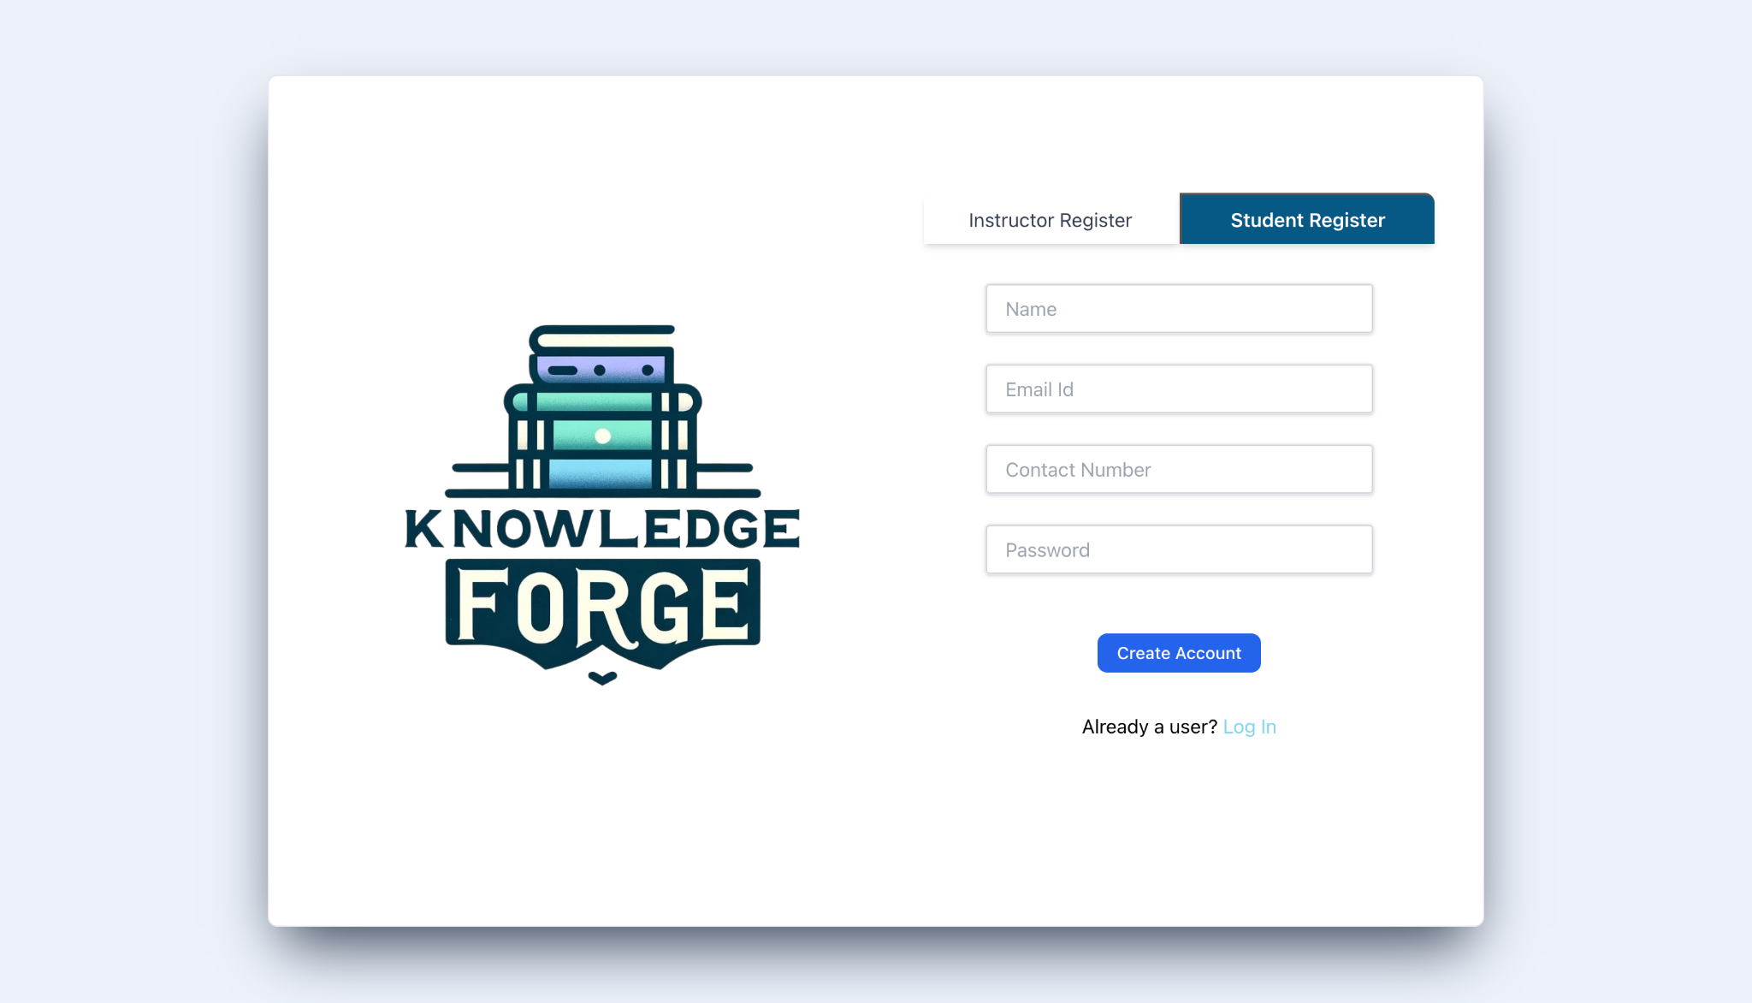
New User and Instructor Registration

Slide 6
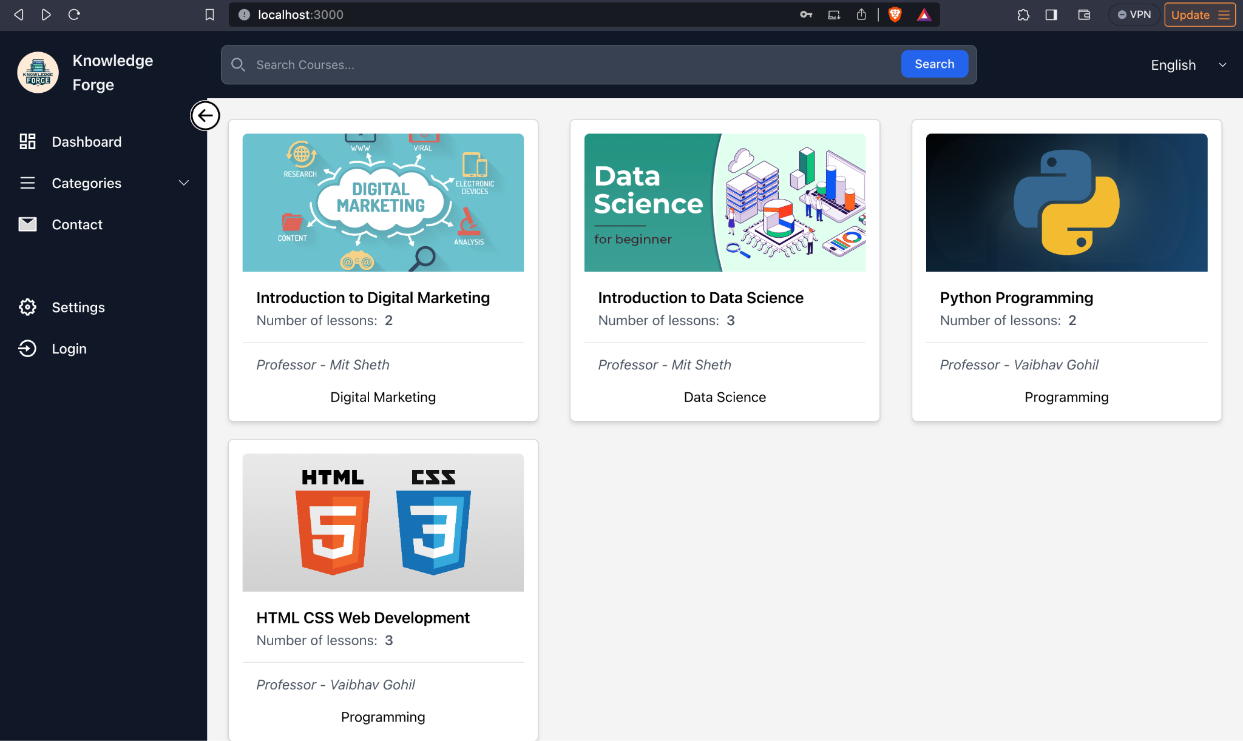
Home Page

Slide 7
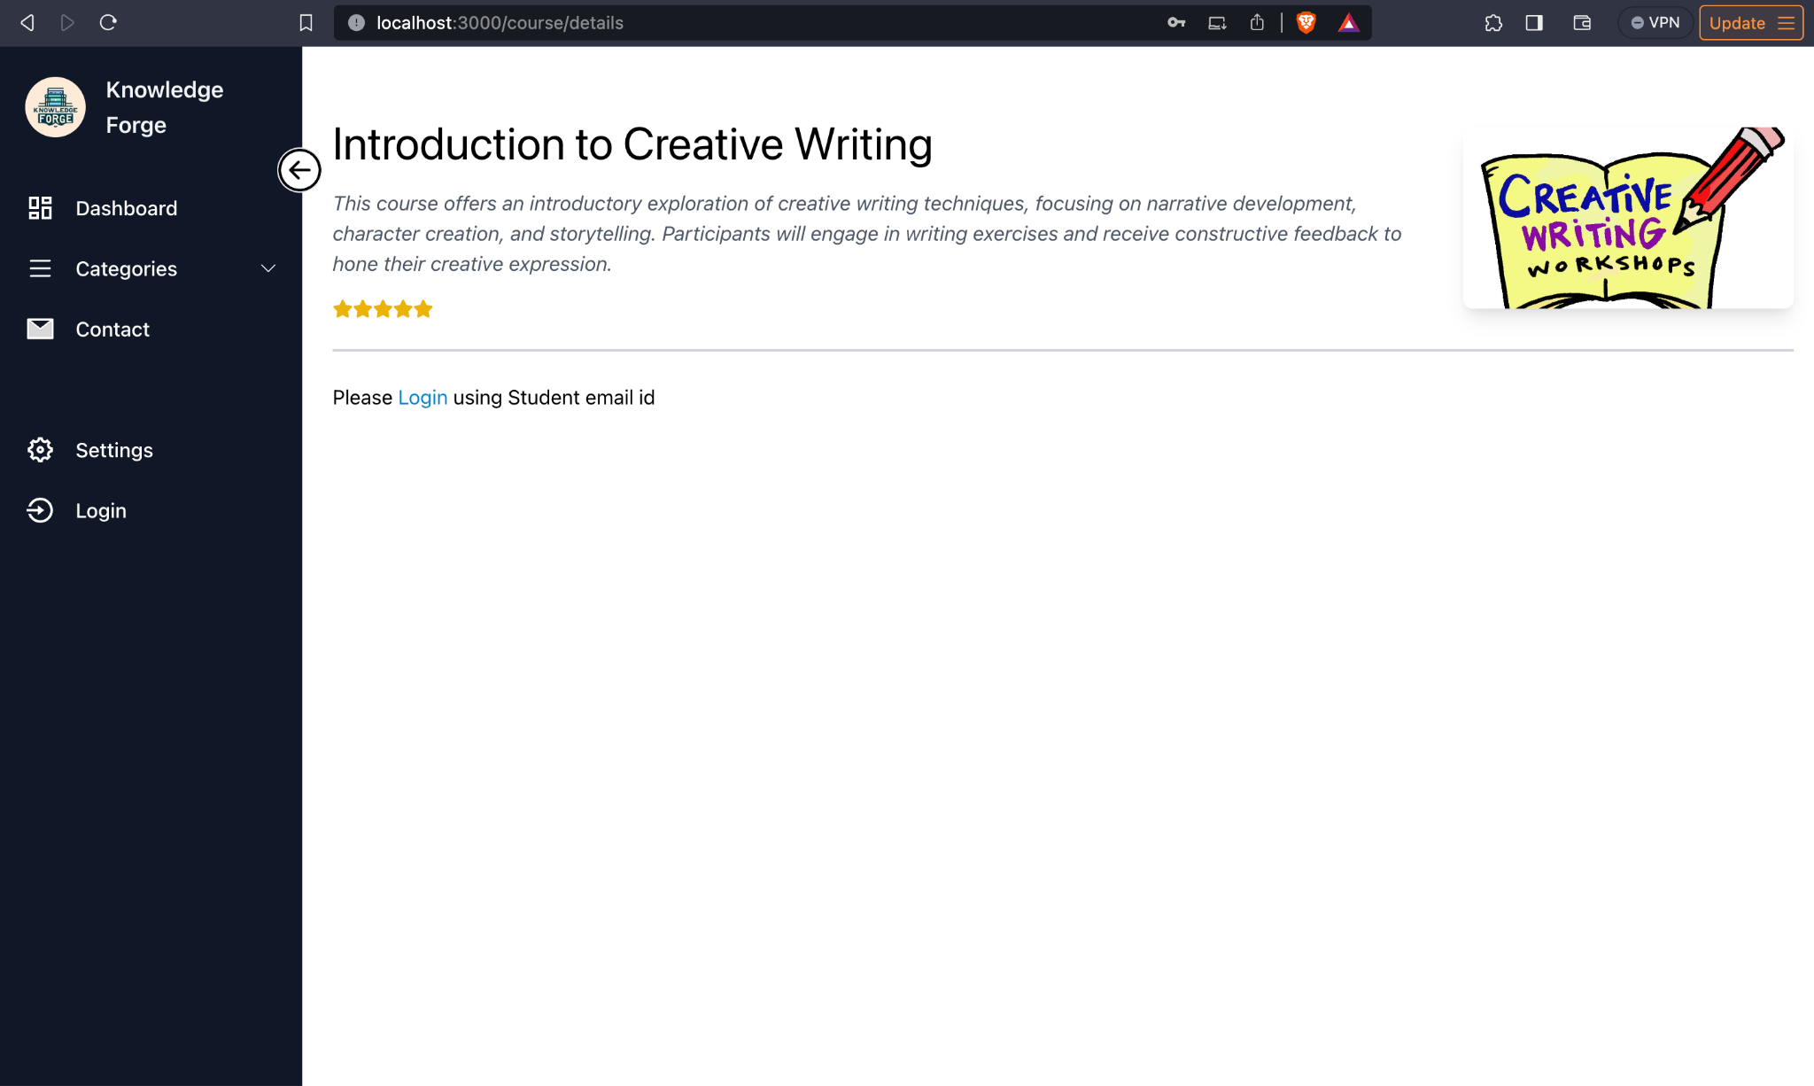
Course for Non Logged in user

Slide 8
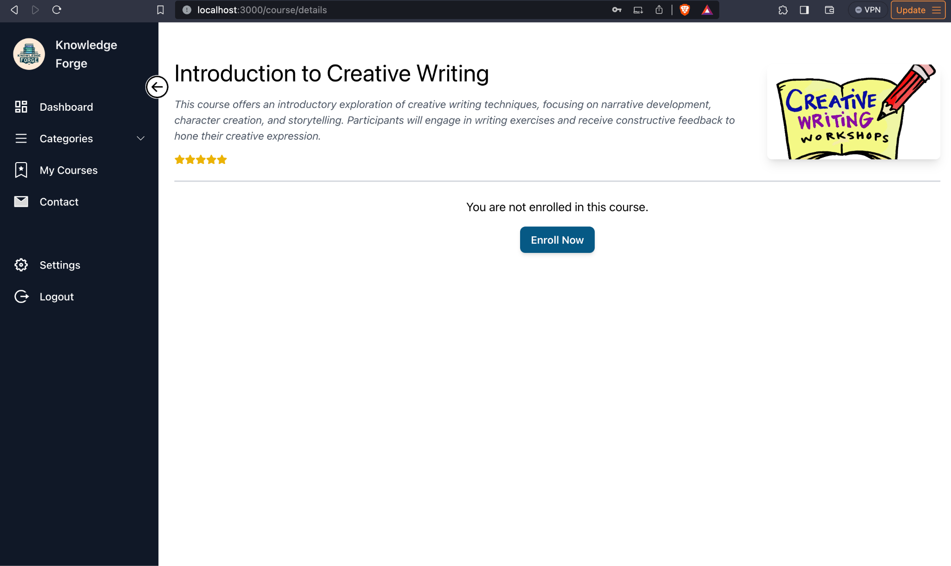
Course detail for non enrolled user

Slide 9
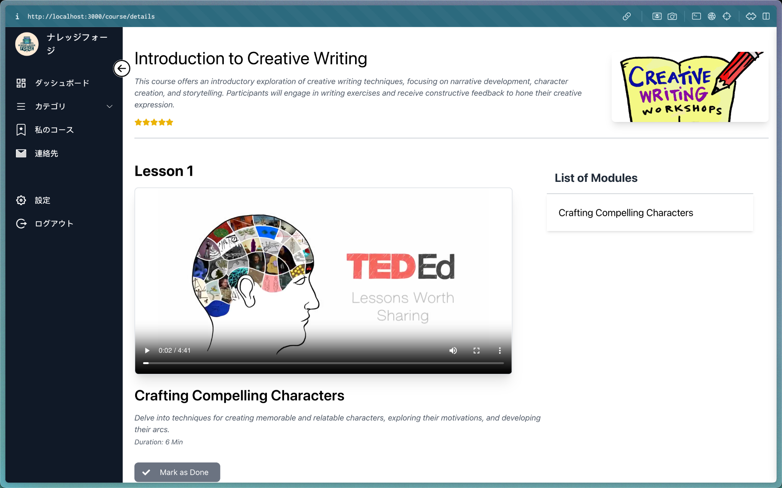
Course for Enrolled user

Slide 10
Thank
You

